Slide 1




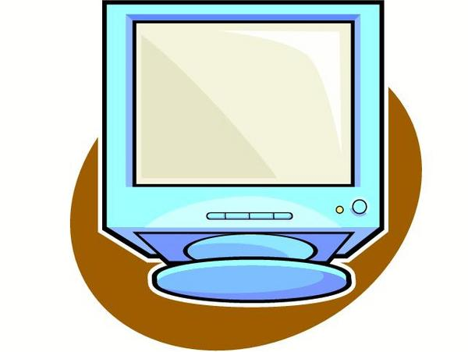



Preventive and curative health care can yield the dividend of biomedical monitoring of space weather by time-structural analyses of ambulatory blood pressure and heart rate series¹
Preventive Self-Help-Based Health Care
Scrutiny of Space Weather Effects
Home
Personal
(Institutional)
Data
Base
Physiological-Sociological Data Base
Ecological Data
Base
Analysis
Data Base
Secure Website
Research Data Base
Repository of encrypted data
Chronobiologic Researchers
ABPM
Wearer
Ever-improved software for analyses
Manual or preferably automatic ambulatory monitoring device
Home computing device
Sphygmochron (summary)²
Ever-evolving diagnostic tests & improved reference standards
School/Military
Sequential testing
∞
Medical Community
Medical
Record
System
(1) by aligning longitudinal and linked cross-sectional biomedical with (whenever possible also local and global) physical environmental monitoring for transdisciplinary science -- while safeguarding anonymity, privacy and security with lifelong follow-up. Vision of Larry A. Beaty (www.sphygmochron.org) of the Phoenix Project (www.phoenix.tc-ieee.org/).• (2) If abnormal, participants are advised to allow data and analyses transfer to care providers for surveillance, diagnosis, optimization of treatment, if and as need be, and for ascertaining continued efficacy.
Care providers
Modified from Figure 1 (Phoenix Architecture) in Adams C Privacy requirements for low-cost chronomedical systems. Int Conf on the Frontiers of Biomedical Science: Chronobiology, Chengdu, China, September 24-26, 2006, p. 64-69.

Slide 2
Preventive (left) and curative (lower right) health care can yield the dividend of biomedical monitoring of space weather (top right) by time-structural analyses of ambulatory blood pressure and heart rate series¹
Preventive Self-Help-Based Health Care
Scrutiny of Space Weather Effects
Home
Personal
(Institutional)
Data
Base
Physiological-Sociological Data Base
Ecological Data
Base
Analysis
Data Base
Secure Website
Research Data Base
Repository of encrypted data
Chronobiologic Researchers
ABPM
Wearer
Ever-improved software for analyses
Manual or preferably automatic ambulatory monitoring device
Home computing device
Sphygmochron (summary)²
Ever-evolving diagnostic tests & improved reference standards
School/Military
Sequential testing
Medical Community
∞
Medical
Record
System
(1) by aligning longitudinal and linked cross-sectional biomedical with (whenever possible also local and global) physical environmental monitoring for transdisciplinary science -- while safeguarding anonymity, privacy and security with lifelong follow-up. Vision of Larry A. Beaty (www.sphygmochron.org) of the Phoenix Project (www.phoenix.tc-ieee.org/).• (2) If abnormal, participants are advised to allow data and analyses transfer to care providers for surveillance, diagnosis, optimization of treatment, if and as need be, and for ascertaining continued efficacy.
Care providers
Modified from Figure 1 (Phoenix Architecture) in Adams C Privacy requirements for low-cost chronomedical systems. Int Conf on the Frontiers of Biomedical Science: Chronobiology, Chengdu, China, September 24-26, 2006, p. 64-69.

